Slide 1
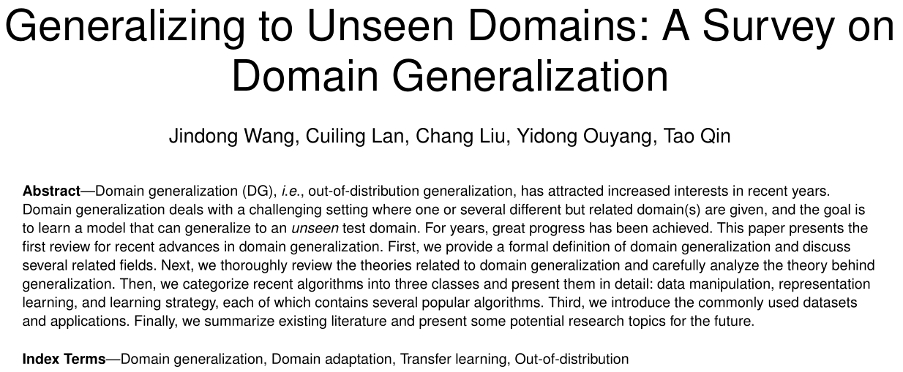

Slide 2
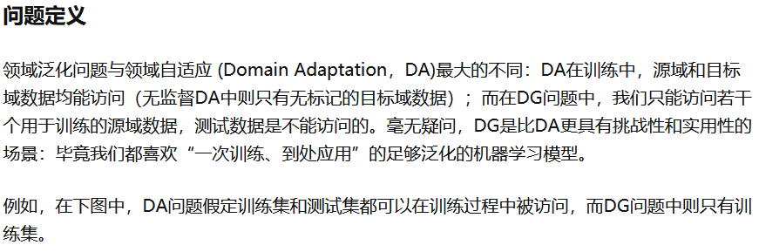
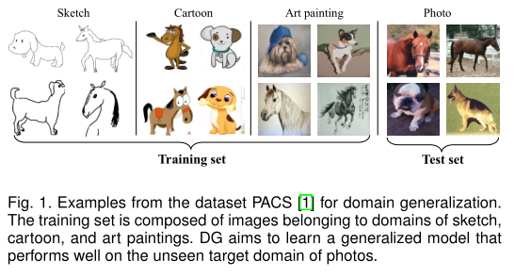

Slide 3
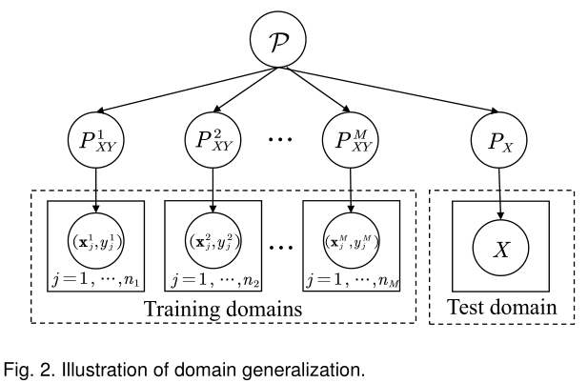
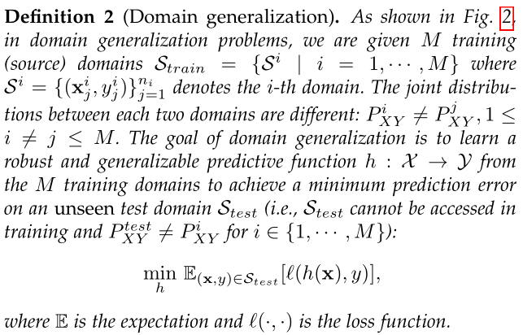

Slide 4
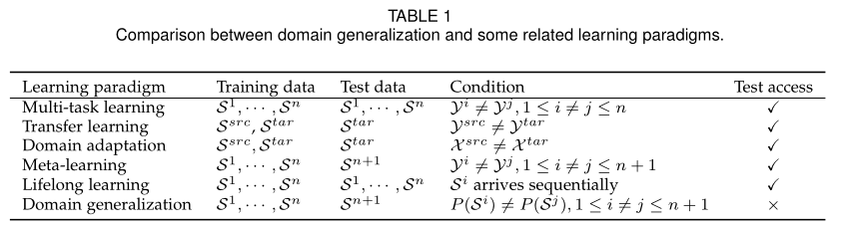

Slide 5
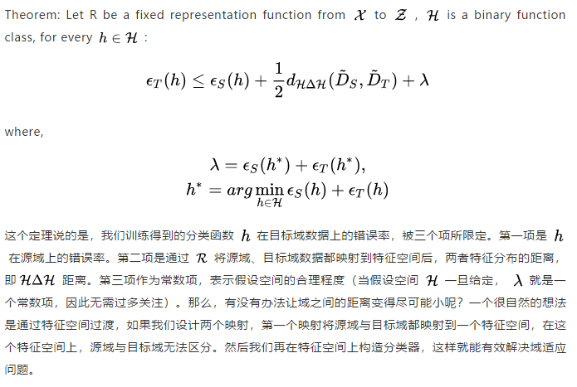
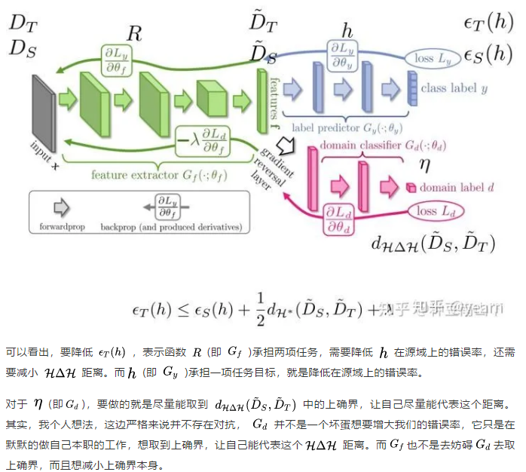
Domain Adaptation
The theory of domain-invariant representations have later inspired many DA/DG methods
Ben-David, Shai, et al. "A theory of learning from different domains." Machine learning 79.1 (2010): 151-175.

Slide 6
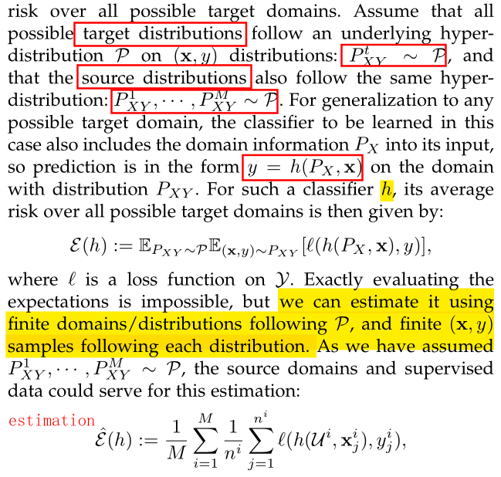
Domain Generalization

Slide 7
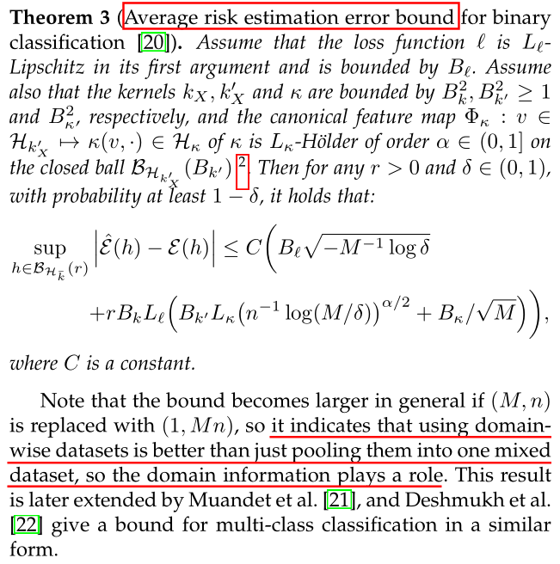
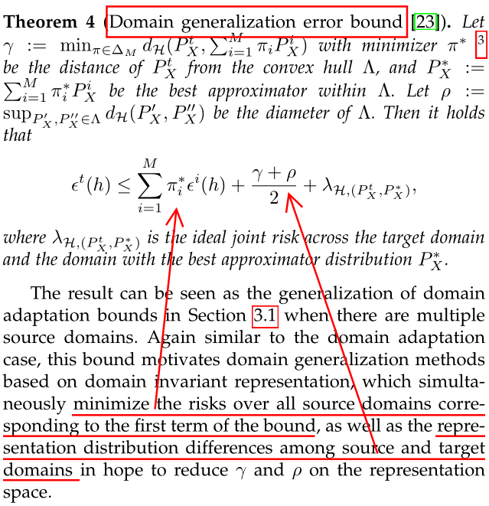
Domain Generalization

Slide 8
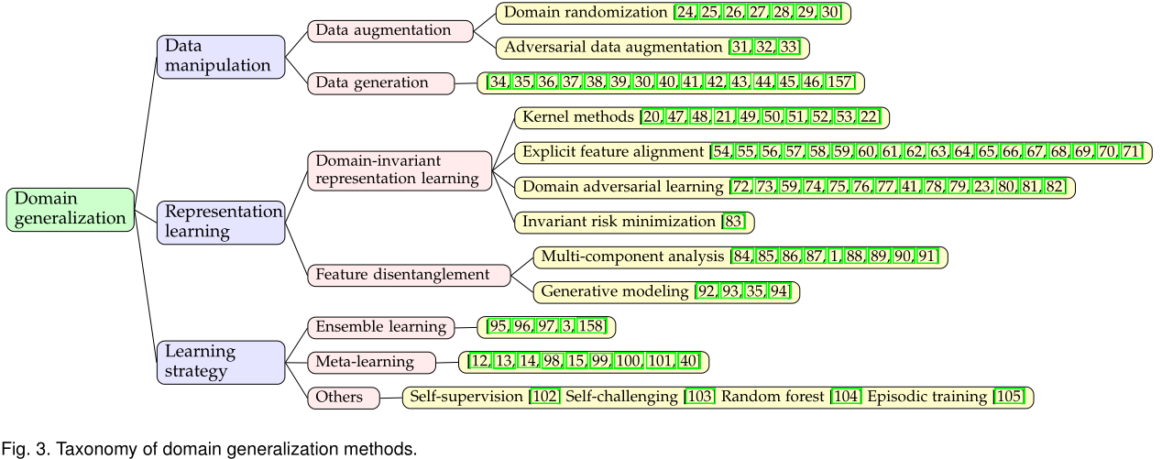
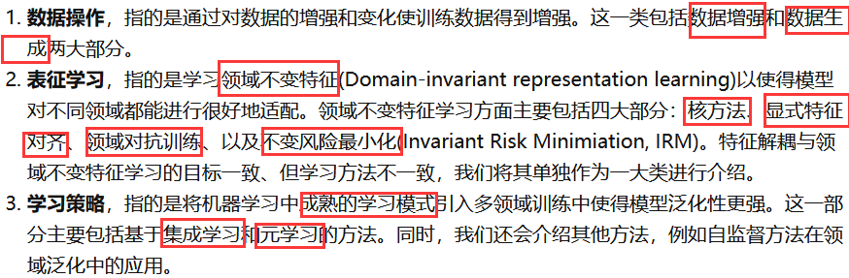
方法

Slide 9
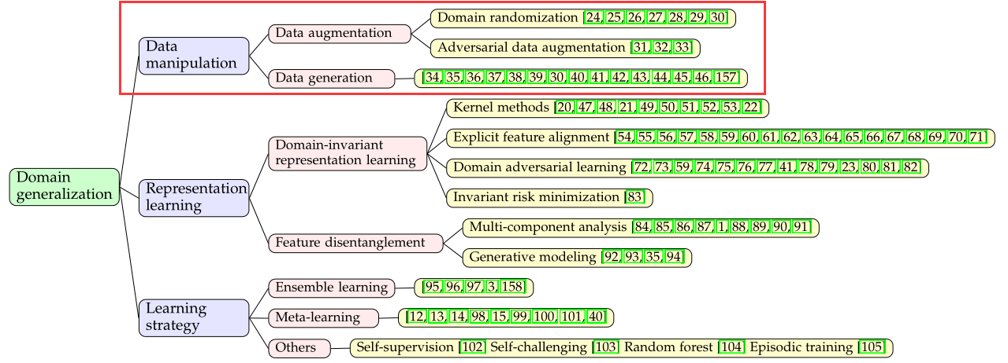
Data manipulation
域随机化
数据增强
数据操作
对抗性数据增强
数据生成

Slide 10
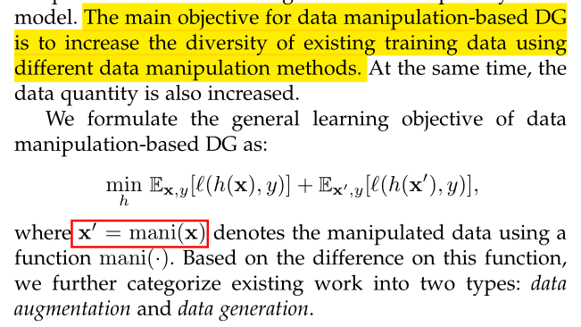
Data manipulation

Slide 11
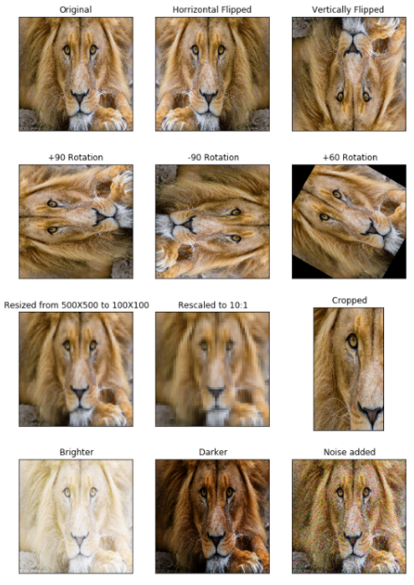
Data manipulation
1. Data augmentation-based DG
Data augmentation: flipping, rotation, scaling, cropping, adding noise
Notes:
想法: ecg 数据使用 Adversarial data augmentation

Slide 12
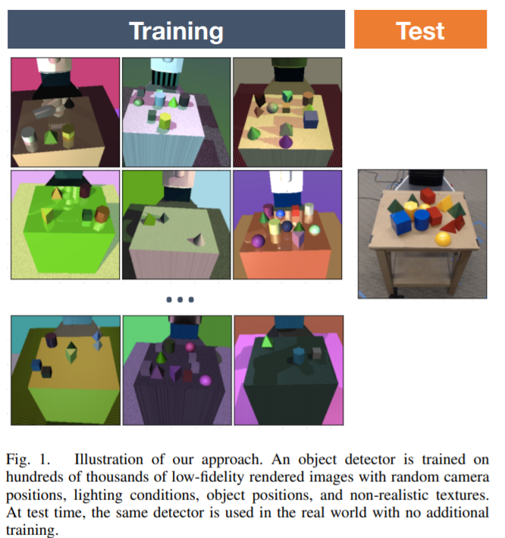
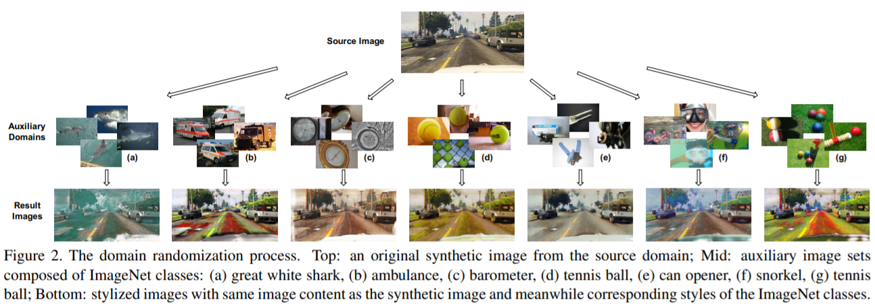
Data manipulation
1. Data augmentation-based DG
Domain randomization
Such as, altering the location and texture of objects, changing the number and shape of objects, modifying the illumination and camera view, and adding different types of random noise to the data.
Tobin, Josh, et al. "Domain randomization for transferring deep neural networks from simulation to the real world." 2017 IEEE/RSJ international conference on intelligent robots and systems (IROS). IEEE, 2017.
X. Yue, Y. Zhang, S. Zhao, A. Sangiovanni-Vincentelli, K. Keutzer, and B. Gong, “Domain randomization and pyramid consistency: Simulation-to-real generalization without accessing target domain data,” in ICCV, 2019, pp. 2100–2110.

Slide 13
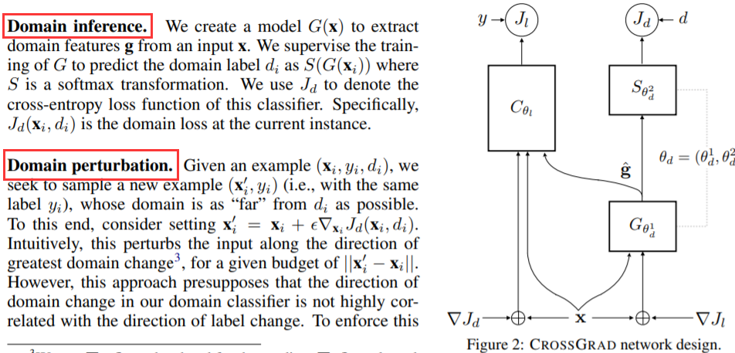
Data manipulation
1. Data augmentation-based DG
Adversarial data augmentation
Adversarial data augmentation aims to guide the augmentation to optimize the generalization capability, by enhancing the diversity of data while assuring their reliability.
S. Shankar, V. Piratla, S. Chakrabarti, S. Chaudhuri, P. Jyothi, and S. Sarawagi, “Generalizing across domains via cross-gradient training,” in ICLR, 2018.

Slide 14
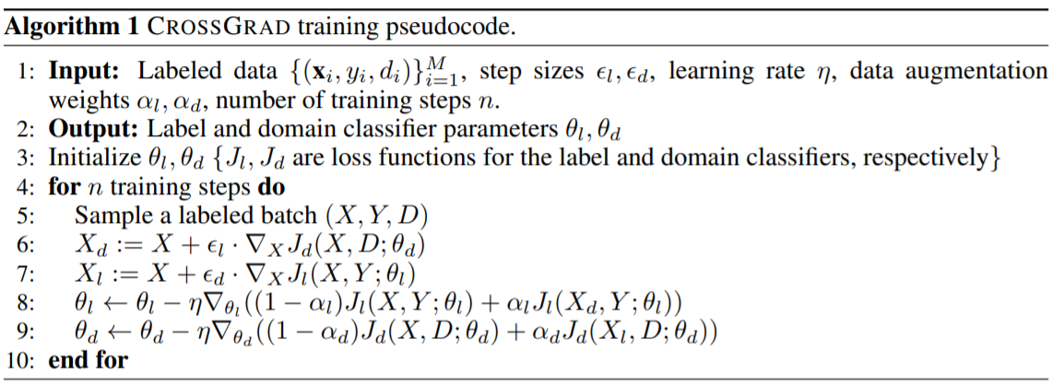
Data manipulation
1. Data augmentation-based DG
Adversarial data augmentation
S. Shankar, V. Piratla, S. Chakrabarti, S. Chaudhuri, P. Jyothi, and S. Sarawagi, “Generalizing across domains via cross-gradient training,” in ICLR, 2018.

Slide 15
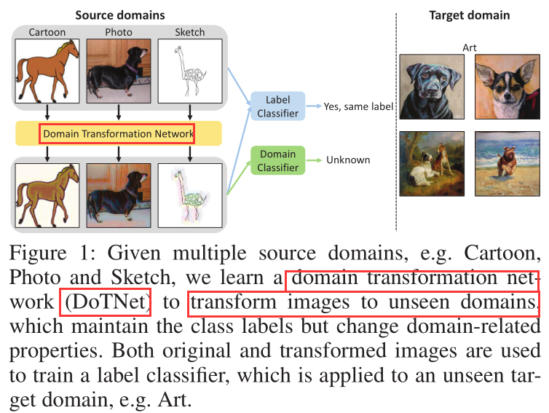
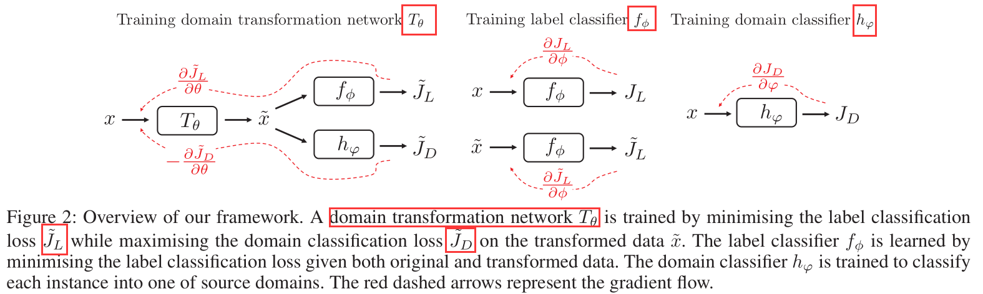
Data manipulation
1. Data augmentation-based DG
Adversarial data augmentation
K. Zhou, Y. Yang, T. Hospedales, and T. Xiang, “Deep domain adversarial image generation for domain generalisation,” in AAAI, 2020

Slide 16
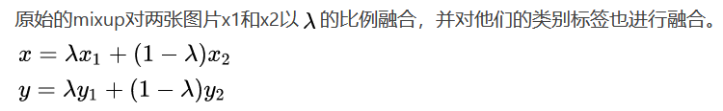
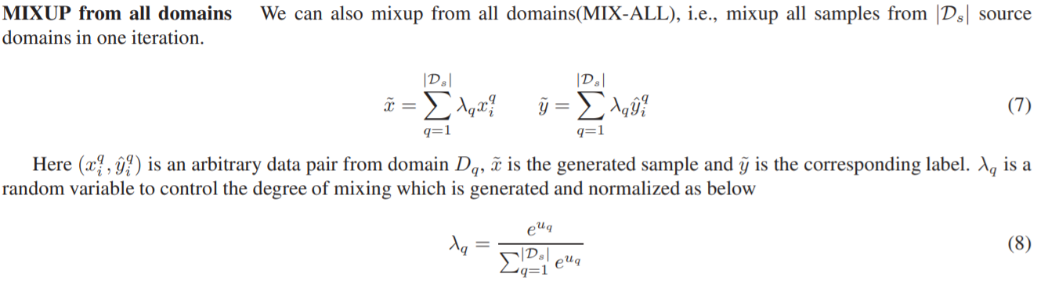
Data manipulation
2. Data generation-based DG
Using generative models, such as, GAN、 VAE、Wasserstein Auto-Encoder (WAE)
Mixup: generates new data by performing linear interpolation between any two instances and between their labels
Mixup in the original space
Y. Wang, H. Li, and A. C. Kot, “Heterogeneous domain generalization via domain mixup,” in ICASSP, 2020, pp. 3622–3626.

Slide 17
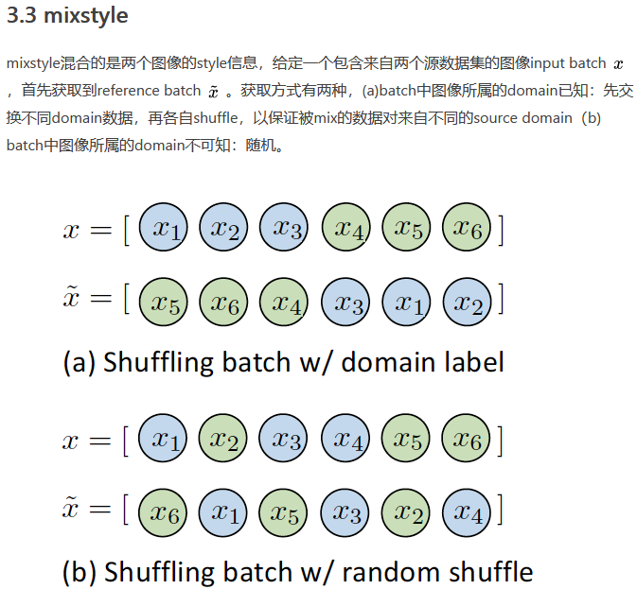
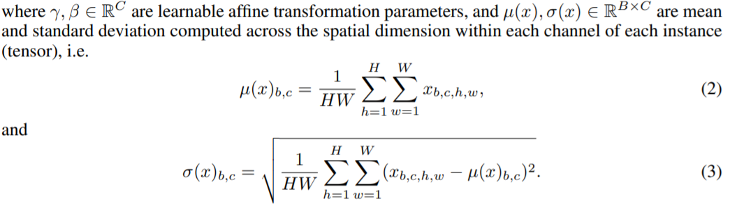
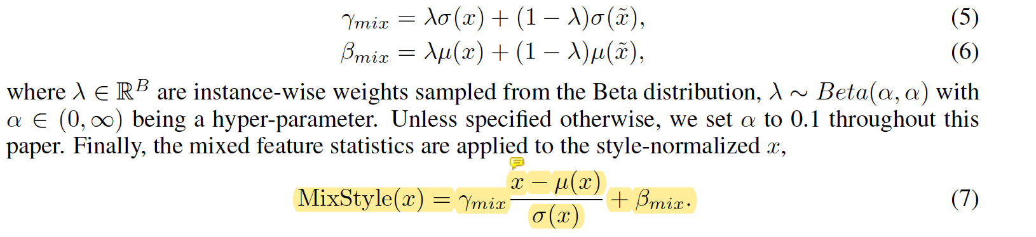
Data manipulation
2. Data generation-based DG
Mixup in the feature space
recent style transfer suggest that such style information is preserved at the bottom layers of the CNN through the instance-level feature statistics. It is reasonable to assume that mixing styles from images of different domains would result in images of (mixed) new styles.
K. Zhou, Y. Yang, Y. Qiao, and T. Xiang, “Domain generalization with mixstyle,” in ICLR, 2021.

Slide 18
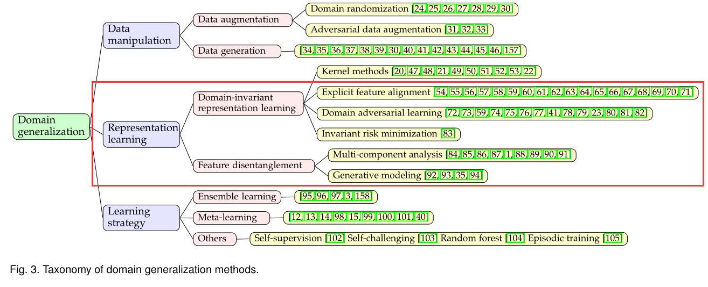
Representation learning
领域不变表征学习
表征学习
特征解耦

Slide 19
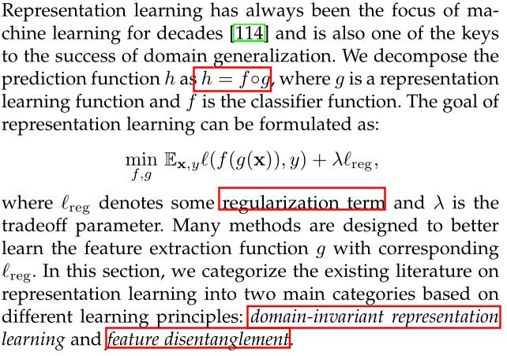
Representation learning

Slide 20
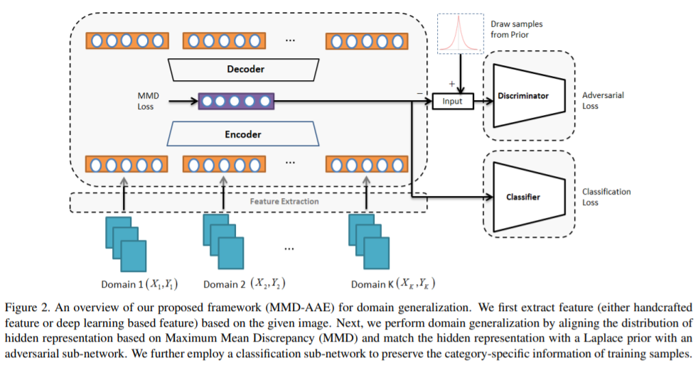
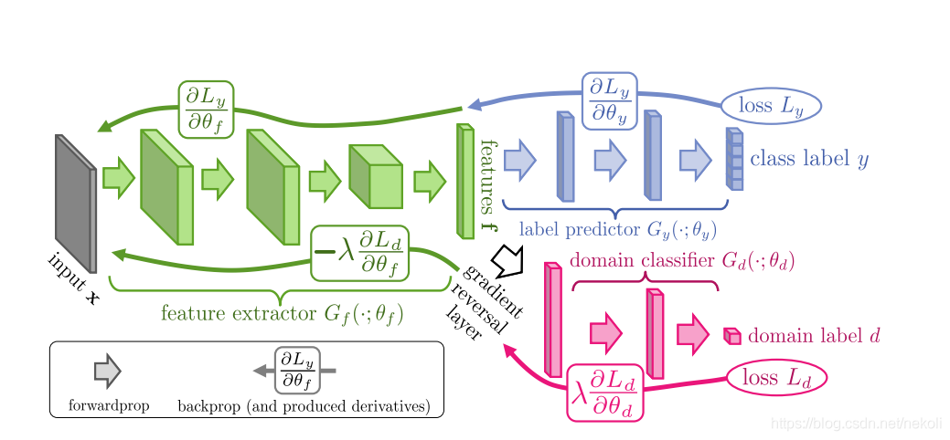
Representation learning
Domain-invariant representation-based DG
Domain adversarial
H. Li, S. J. Pan, S. Wang, and A. Kot, “Domain generalizationwith adversarial feature learning,” in CVPR, 2018, pp. 5400–5409.

Slide 21
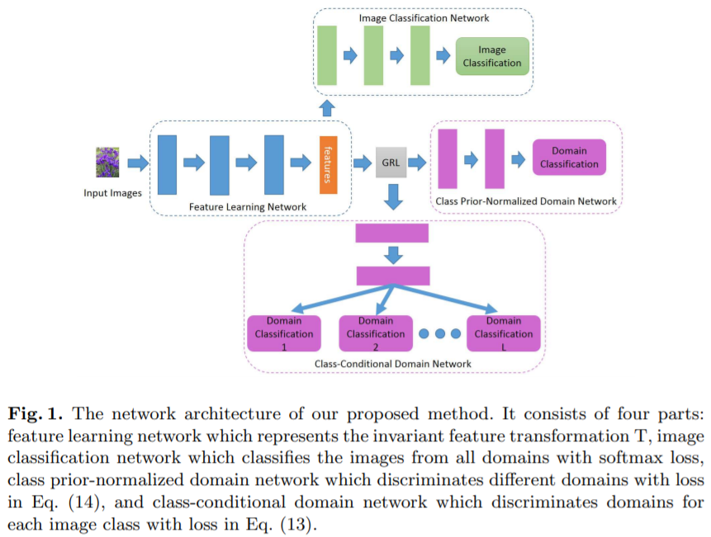
Representation learning
Domain-invariant representation-based DG
Domain adversarial
Y. Li, X. Tian, M. Gong, Y. Liu, T. Liu, K. Zhang, and D. Tao, “Deep domain generalization via conditional invariant adversarial networks,” in ECCV, 2018, pp. 624–639.

Slide 22
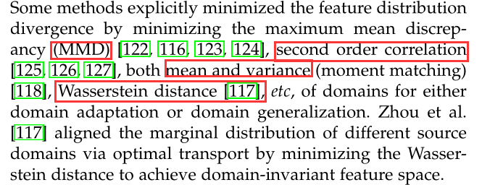
Representation learning
Domain-invariant representation-based DG
Explicit feature alignment
Invariant risk minimization (IRM)
another perspective on the domain-invariance of representation for domain generalization

Slide 23
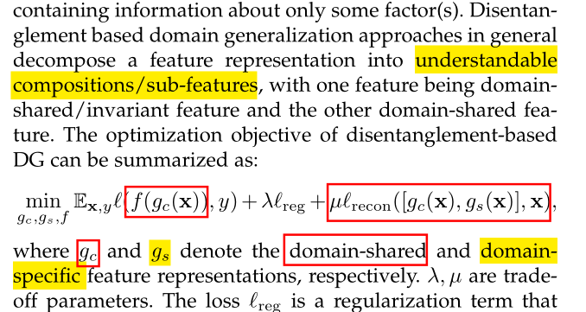
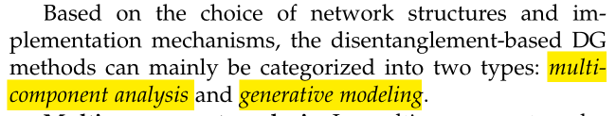
Representation learning
Feature disentanglement-based DG
The goal of disentangled representation learning is to learn a function that maps a sample to a feature vector that contains all the information about different factors of variation, with each dimension (or a subset of dimensions) containing information about only some factor(s).

Slide 24
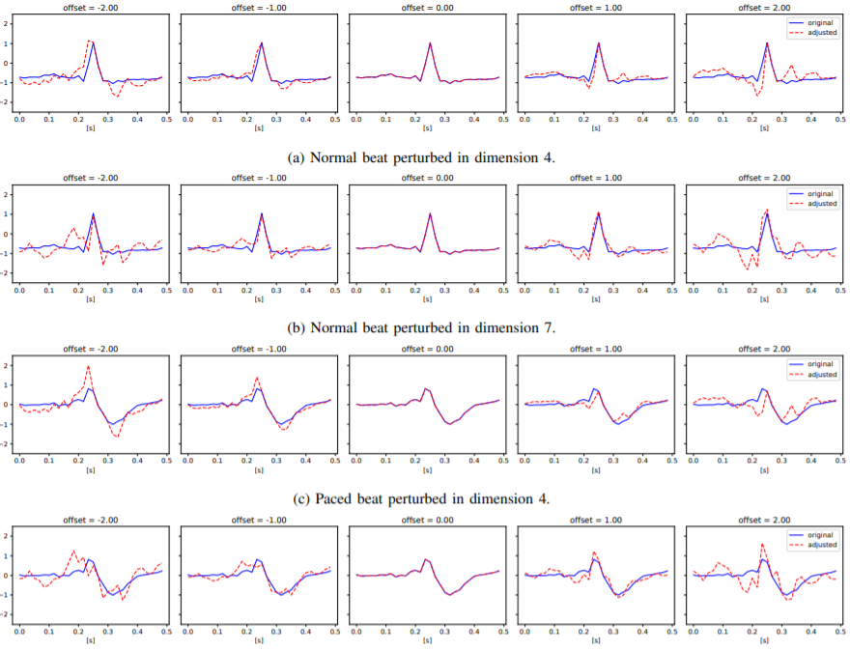
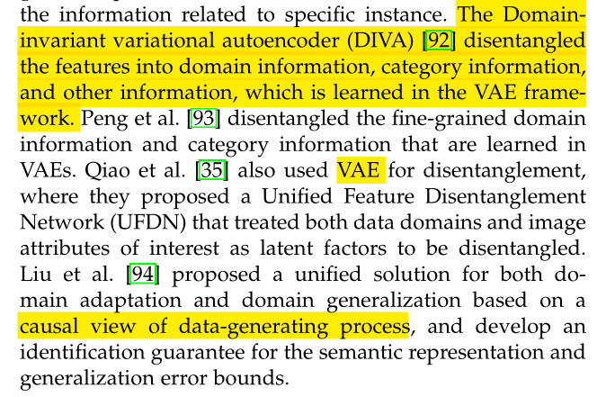
Representation learning
Feature disentanglement-based DG
Multi-component analysis
In multi-component analysis, the domain-shared and domain-specific features are in general extracted using the domain-shared and domain-specific network parameters.
Generative modeling
Generative models can be used for disentanglement from the perspective of data generation process.
Notes:
M. Ilse, J. M. Tomczak, C. Louizos, and M. Welling, “Diva: Domain invariant variational autoencoders,” in Proceedings of the Third Conference on Medical Imaging with Deep Learning, 2020.

Slide 25
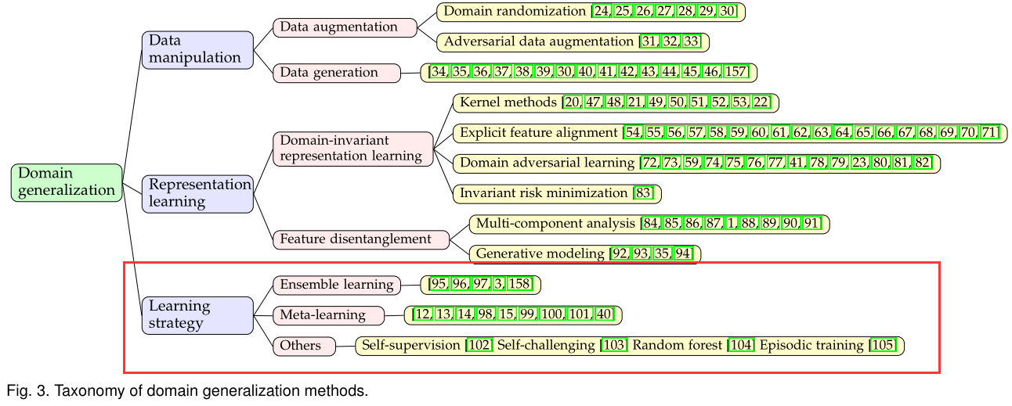
Learning strategy
集成学习
元学习
学习策略
其他

Slide 26
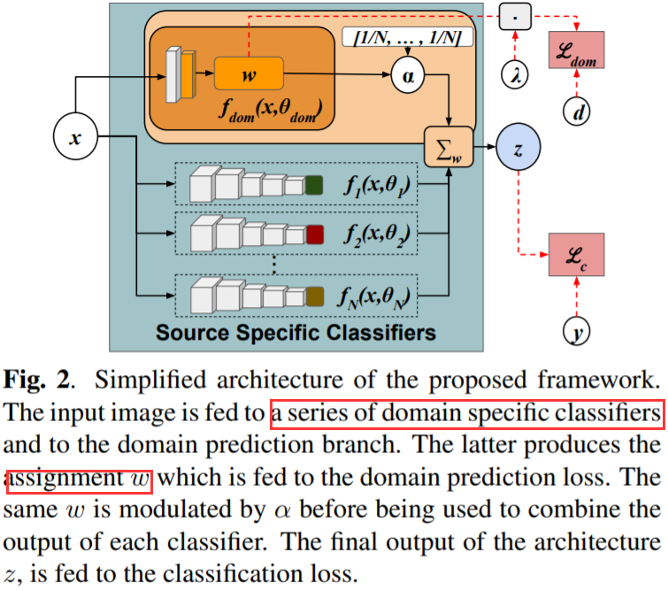
Learning strategy
Ensemble learning-based DG
For domain generalization, ensemble learning exploits the relationship between multiple source domains by using specific network architecture designs and training strategies to improve generalization.
use learnable weights for aggregating the predictions from different source specific classifiers, where a domain predictor is used to predict the probability that a sample belongs to each domain (weights).
M. Mancini, S. R. Bulò, B. Caputo, and E. Ricci, “Best sources forward: domain generalization through source-specific nets,” in
ICIP, 2018, pp. 1353–1357.

Slide 27
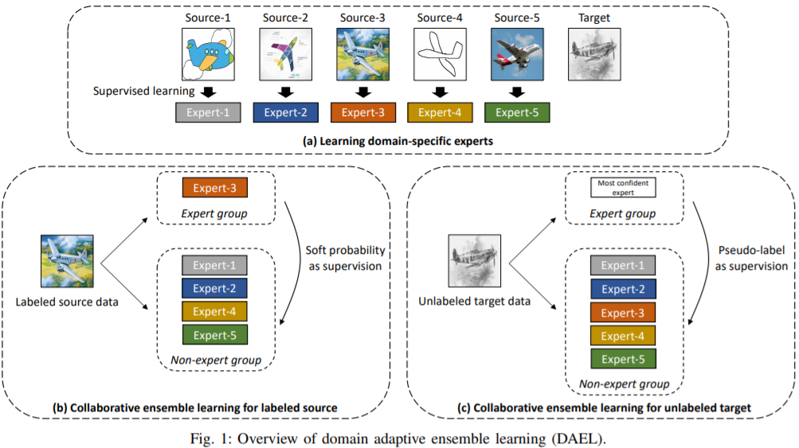
Learning strategy
Ensemble learning-based DG
proposed Domain Adaptive Ensemble Learning (DAEL), where a DAEL model is composed of a CNN feature extractor shared across domains and multiple domain-specific classifier heads. Each classifier is an expert to its own domain and a non-expert to others. DAEL aims to learn these experts collaboratively, by teaching the non-experts with the expert so as to encour-age the ensemble learn how to handle data from unseen domains.
K. Zhou, Y. Yang, Y. Qiao, and T. Xiang, “Domain adaptive ensemble learning,” arXiv preprint arXiv:2003.07325, 2020.

Slide 28
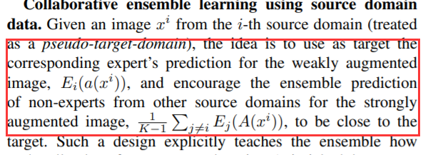
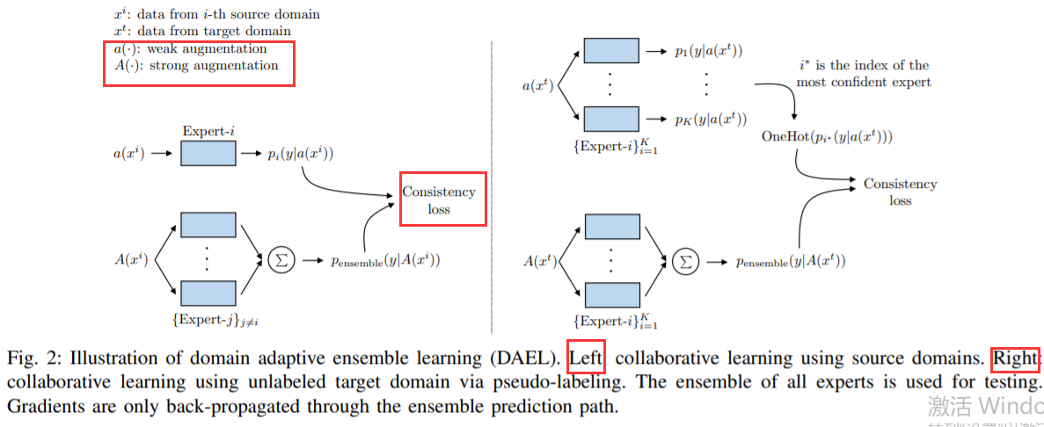
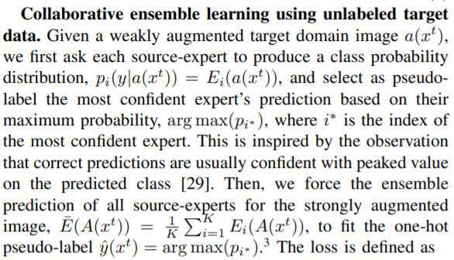
Learning strategy
Ensemble learning-based DG
K. Zhou, Y. Yang, Y. Qiao, and T. Xiang, “Domain adaptive ensemble learning,” arXiv preprint arXiv:2003.07325, 2020.

Slide 29
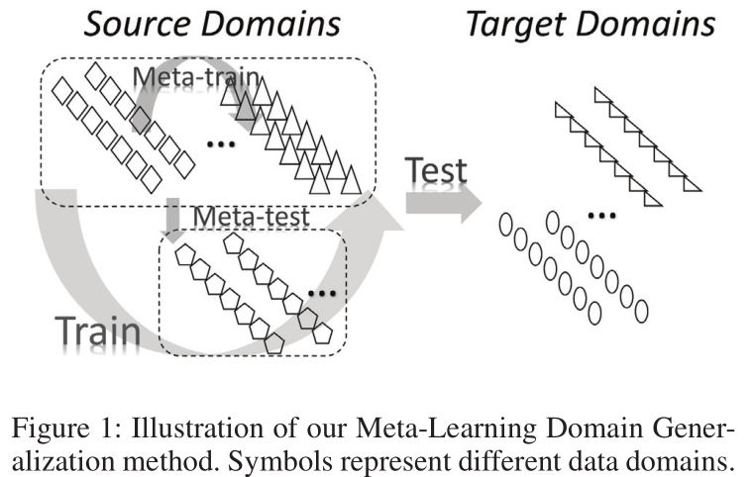
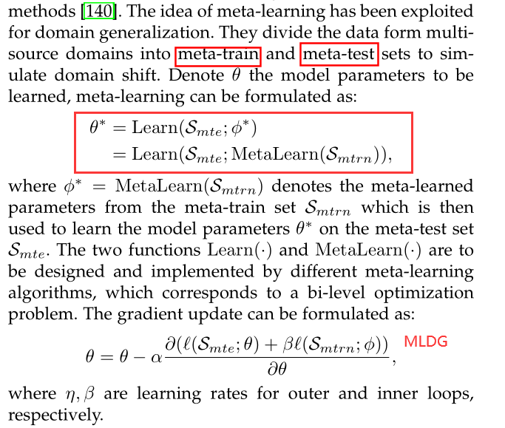
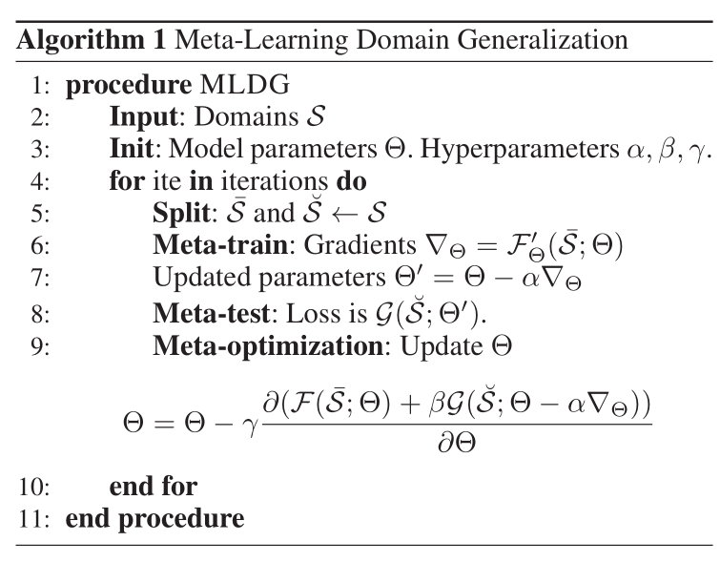
Learning strategy
2. Meta-learning-based DG
D. Li, Y. Yang, Y.-Z. Song, and T. M. Hospedales, “Learning to generalize: Meta-learning for domain generalization,” in AAAI, 2018.

Slide 30
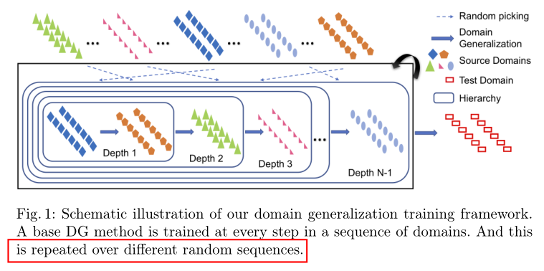
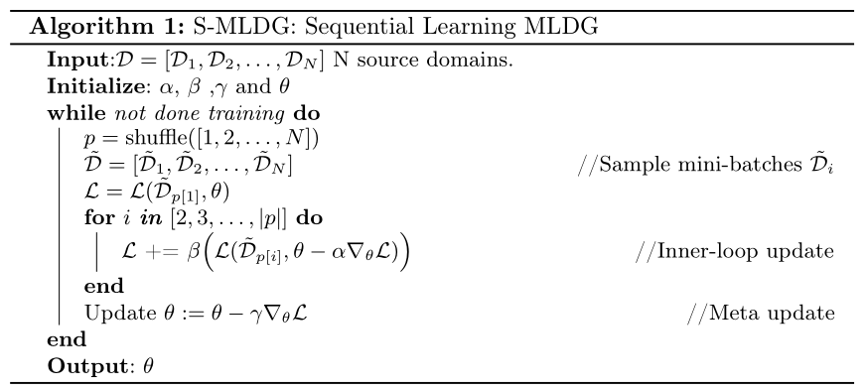
Learning strategy
2. Meta-learning-based DG
within the meta-train domains, MLDG simply aggregates them. It does not exploit their domain grouping. To instantiate our hierarchical training framework for MLDG we imagine recursively applying MLDG. For a given meta-test/meta-train split, we apply MLDG again within the meta-train split until there is only a single domain in the meta-train set.
Li, Da, et al. "Sequential Learning for Domain Generalization." European Conference on Computer Vision. Springer, Cham, 2020.

Slide 31
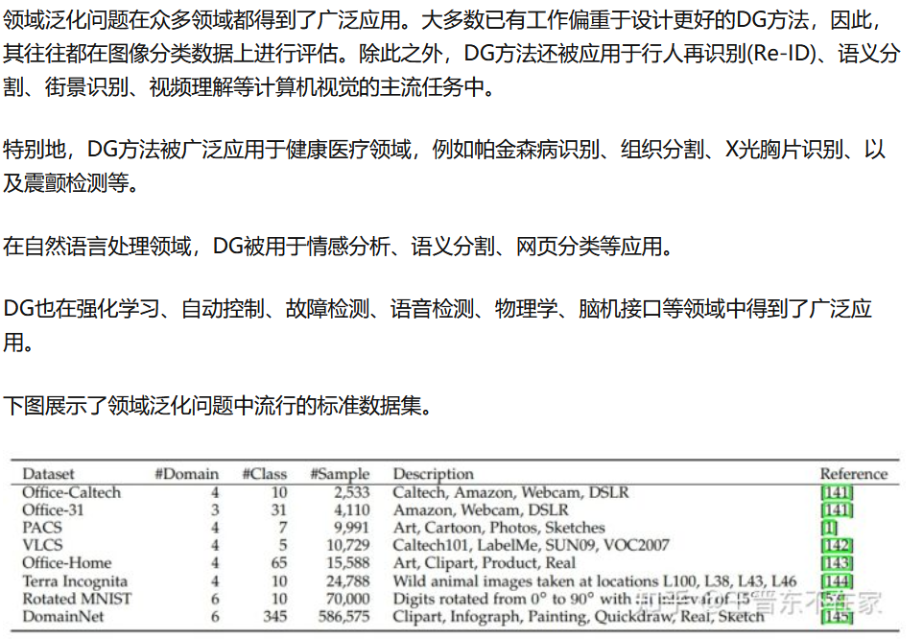
应用与数据集

Slide 32
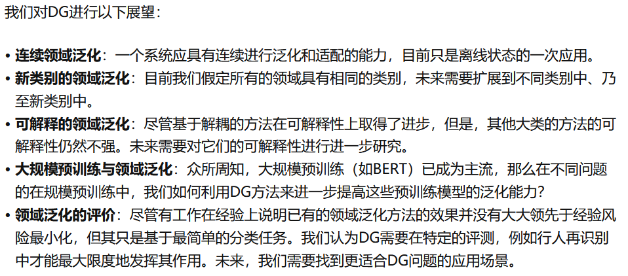
未来挑战

